Slide 1
Nikhith Birru - 11654339
Eshwitha Naini - 11609231
Pavan Manindra varma - 11597110
Bhanu Prasad Kommula – 11590771
Naquibuddin Shaik - 11602741
Group No 15
DTSC 5082
1

Slide 2
Automated Evaluation of Speech Responses using Deep Learning
2

Slide 3
Agenda
Title
Motivation
Background
Abstract(Problem statement)
Literature Survey
Objectives of the Study
Data Set and Data Processing
Research Design(Blueprint/Workflow)
Data Analysis and Model Description
Data Visualization and Results
Conclusion
References

Slide 4

Motivation
Title: Driving Forces Behind Automated Grading
Time Efficiency: Manual grading is time-consuming.
Subjectivity: Human grading lacks consistency.
Educational Context: Importance of timely feedback for learners.
Language Assessment: Need for objective evaluation criteria.
Advancements in AI: Leveraging deep learning for text analysis.
Potential Impact: Streamlining assessment processes, saving time.

Slide 5

Background
Importance of Language Assessment:
Language assessment plays a crucial role in various fields, including education, recruitment, and immigration.
Accurate evaluation of language proficiency is essential for making informed decisions about language learners' abilities and readiness for specific tasks or roles.
Challenges in Traditional Assessment Methods:
Traditional language assessment methods often rely on subjective human judgment, leading to inconsistencies and biases.
Manual evaluation processes can be time-consuming, expensive, and impractical for large-scale assessments.

Slide 6
Problem Statement
Title: Addressing Manual Grading Challenges
Description: Manual grading in educational and language assessment contexts is time-consuming and subjective.
Challenges: Lack of consistency, labor-intensive, delays in feedback.
Put in place procedures to deal without considering the speech patterns, accents, and audio quality while preserving the accuracy of automated evaluation findings.
Examine how neural networking models and natural language processing methods may be used to improve the comprehension of semantic structures in speech replies.
In a Future scope we can provide an intuitive user interface that makes it easy for test-takers to engage with the automated assessment system, promoting efficient learning and progress.
Objective: Develop an automated grading system to streamline assessment processes.

Slide 7
Literature Survey
Automated Language Essay Scoring (AES) systems, leveraging NLP and machine learning, address time-consuming grading issues (Hussein et al., 2019). The review emphasizes the shift to deep learning for better scoring accuracy. However, challenges remain in assessing creativity, underscoring the need for ongoing system enhancement.
The Assessment Use Argument (AUA) outlines the interconnectedness of test taker performance, assessment records, interpretations of ability, decision-making, and consequences (Bachman & Adrian, 2022). It guides language test development, emphasizing adherence to explicit procedures for validity and reliability, and promotes transparency, fairness, and meaningful assessment practices.
The applied linguistics field has explored language assessment literacy, examining its definition and stakeholder variations (Giraldo, 2018). The article reviews assessment literacy from various perspectives and proposes a core set of knowledge, skills, and principles for language teachers.

Slide 8
Objectives:
To build a scoring essay system by implementing deep learning methodologies, such as Bidirectional LSTM and feedforward neural networks over speech data.
Assess the effectiveness and reliability of the developed model through comprehensive evaluation metrics.
Summarizing key findings, discuss implications, and suggest future research directions.

Slide 9
Dataset
ASAP-AES Dataset: Automated Student Assessment Prize - Automated Essay Scoring dataset from OSP which is a free and open-source for research and collaboration.
This dataset is a collection of essays written by students along with corresponding scores assigned by human raters.
Dataset contains 28 features in total. Key features of the dataset are as follows:
essay_id: Unique identifier for each essay
topic: Topic Identifier
essay: Text of the essay
rater1_domain1, rater2_domain1, rater3_domain1: Scores assigned by human raters for domain 1.
rater1_domain2, rater2_domain2: Scores assigned by human raters for domain 2.
target_score: Target score based on the essay topic.
Reference: https://osf.io/9fdrw/

Slide 10
Data Preprocessing
Handling Null Values: Handled Null values methodically to ensure the preservation of data integrity and coherence.
Language Correction: Using langaue_tool_python module, Rectifying errors such as mispronunciation, inaccuracies from speech recognition, spelling and grammar corrections.
Tokenization: The corrected dataset was tokenized using SpaCy module extracting valuable linguistic features from text data such as tokens, lemmatized tokens, parts-of-speech, Entity Recognition after removing stop and punctation from the text.
Feature Engineering: Generating vectorized features from essay such as token count, lemmatoken count, pos count, sentence count etc., so as to capture vocabulary richness and help model in differentiating essays.

Slide 11
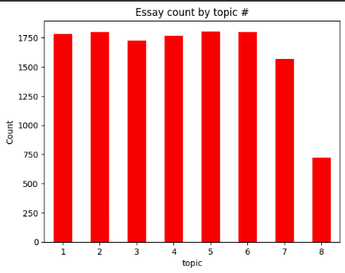
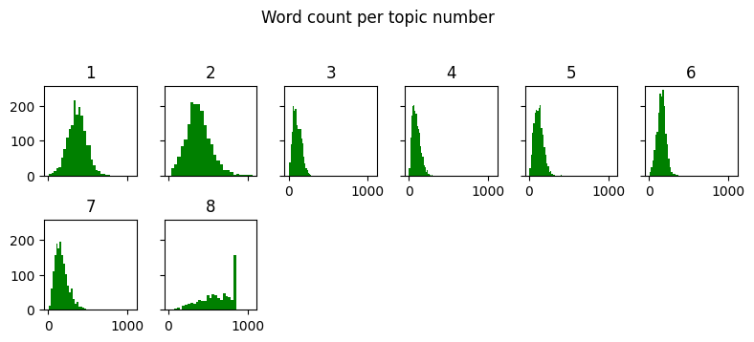
Exploratory Data Analysis
Our dataset hold 12974 entries with essays related to 8 topics.

Slide 12
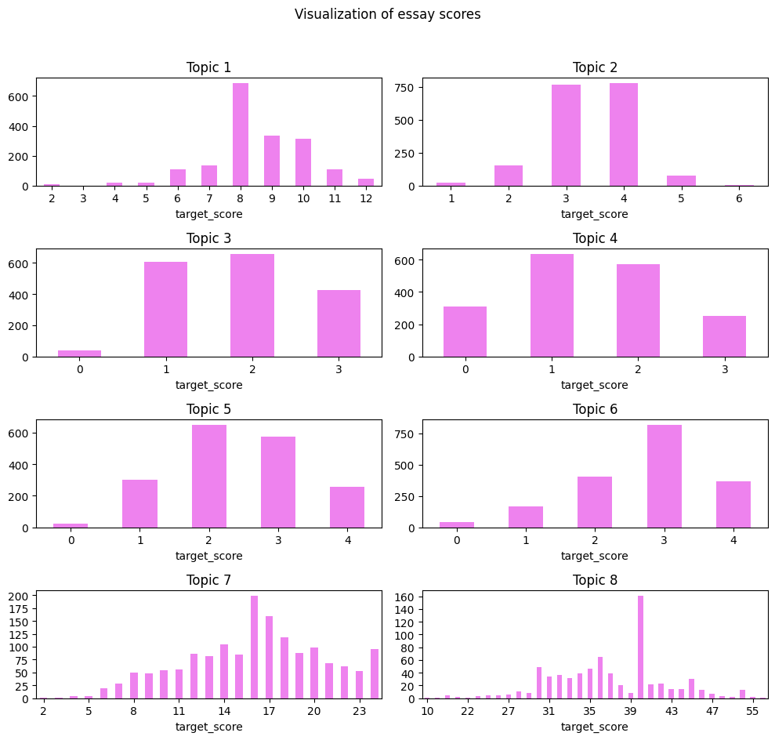
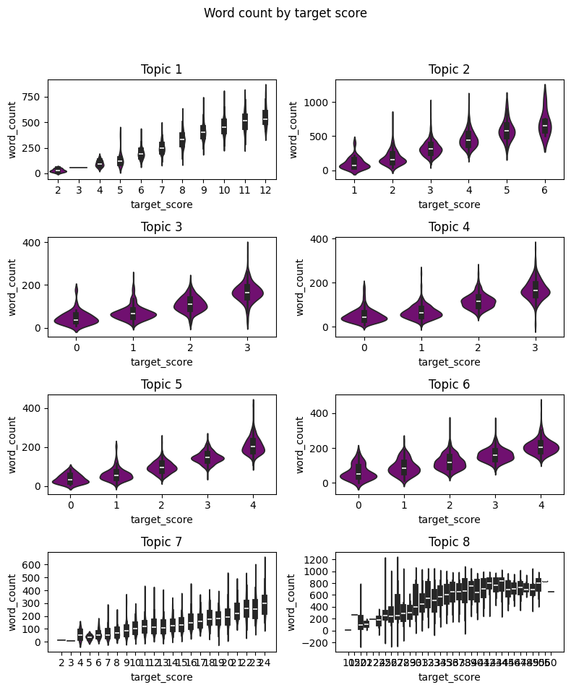
Exploratory Data Analysis

Slide 13
Exploratory Data Analysis
Language Correction
TextBlob and LanguageTool(‘en-US’) -> matches.
Tokenization
SpaCy : NLP library used for tokenization.
STOP_WORDS and punctuation.
Pre-trained English Language processing models: en_core_web_sm, en_core_web_md, en_core_web_lg.
Result: Tokens, Lemmatized tokens, POS, Sentences, NER (Nouns)
Vectorized Features
Applied Feature Engineering to feed to Neural Network.
Ex: Token_Count, Comma, Question, Exclamation, Quotation, Caps, Verb, Adv, etc., using SpaCy’s POS and corrections.

Slide 14
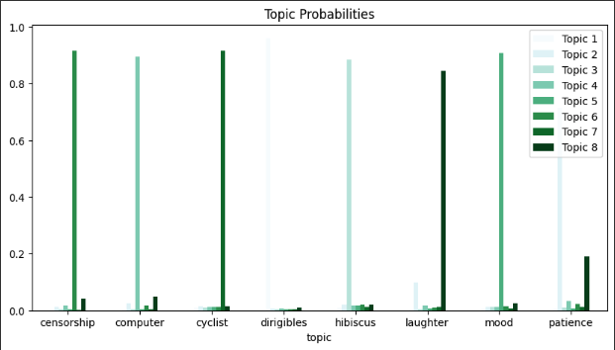
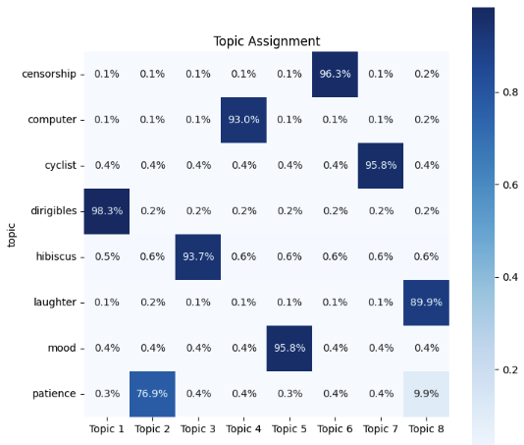
Exploratory Data Analysis
Topic Modeling with Latent Dirichlet Allocation LDA
It’s a Bayesian Network used to compute most probable words per essay.
CountVectorizer is used to convert the essays into numerical representation (i.e., document-term matrix)
LDA model is fitted using this matrix to provide probability of each word belonging to respective topic.

Slide 15
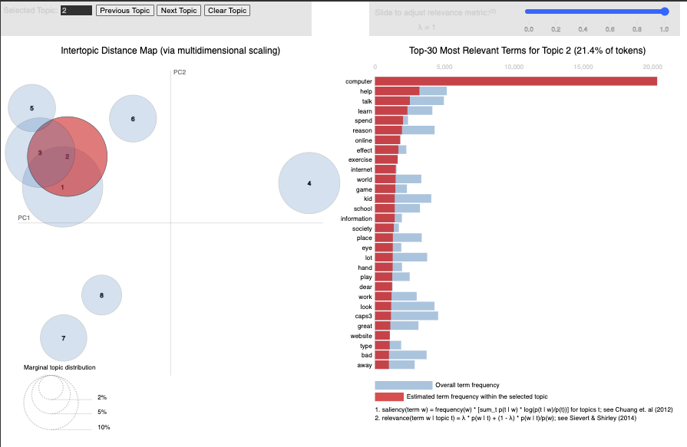
Exploratory Data Analysis
Visualization with PyLDAVis
Helps user interpret the topics in a topic model.

Slide 16
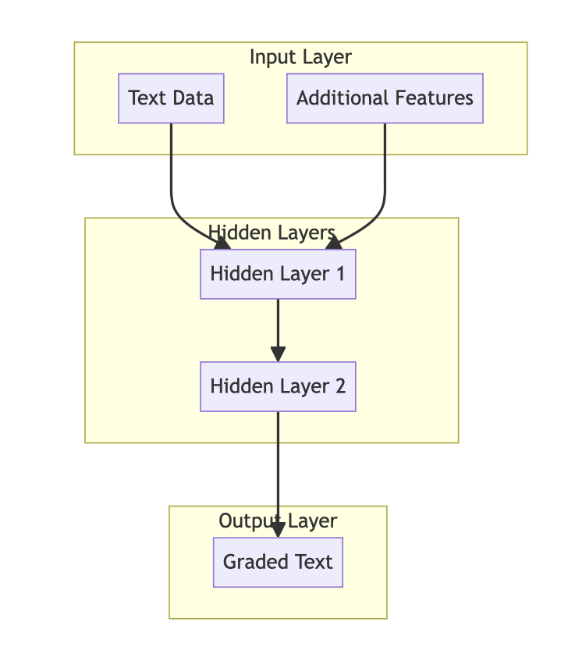
Research Design
Audio Data

Slide 17
Model Architecture
Data Preprocessing
Raw Essays
Language Correction
Tokenization
Additional Features
Word Embedding
Neural Network Model
LSTM
Dropout
Flatten Layer
Dense Layer
Output

Slide 18
Model Training and Evaluation
Approach 1 – Here our aim is to build a model, where each individual topics essays were used as input to model and then compare the predicted and actual scores.
Approach 2 – In this approach we build a model, wherein we gave all topic essays together to model and then compare the predicted and Actual score.
Final observation is mean quadratic kappa score.
 | topic | assignment
0 | censorship | Topic 2
1 | computer | Topic 5
2 | cyclist | Topic 1
3 | dirigibles | Topic 8
4 | hibiscus | Topic 6
5 | laughter | Topic 3
6 | mood | Topic 6
7 | patience | Topic 3

Slide 19
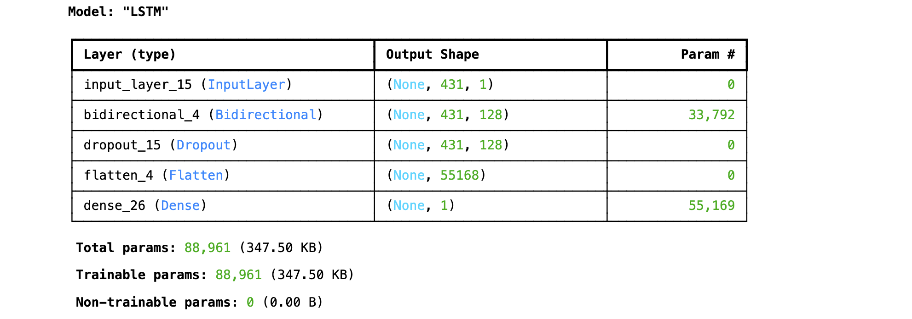
Bidirectional LSTM is a recurrent neural network used for sequential prediction problems. We used this model to analyze the context of essays by processing the sequence of words.
Loss Function: Mean Squared error
Adam optimizer was used for efficient weight updates.
Kappa Score was used to evaluate the predicted scores with actual scores

Slide 20
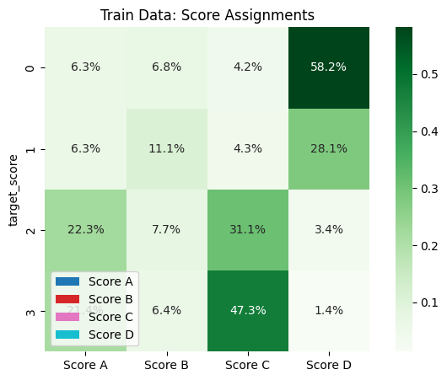
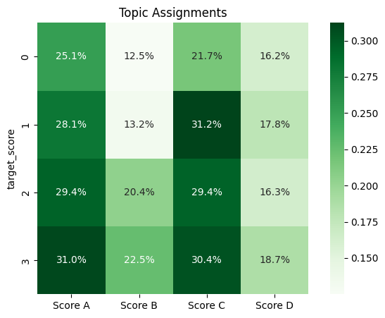
Data Visualization

Slide 21
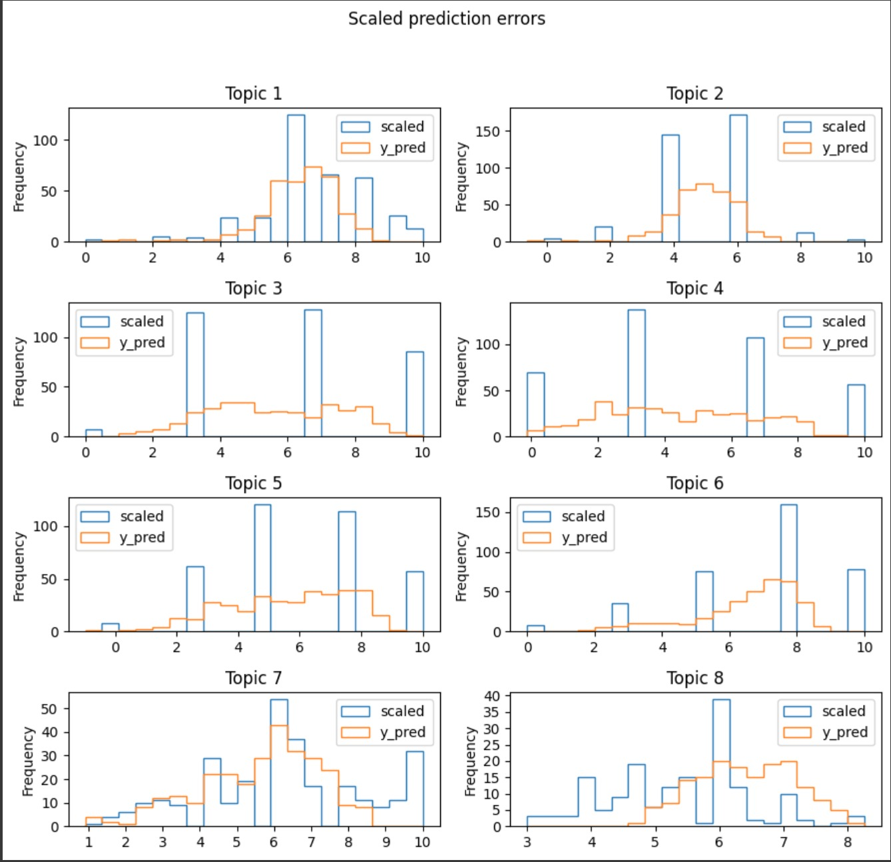
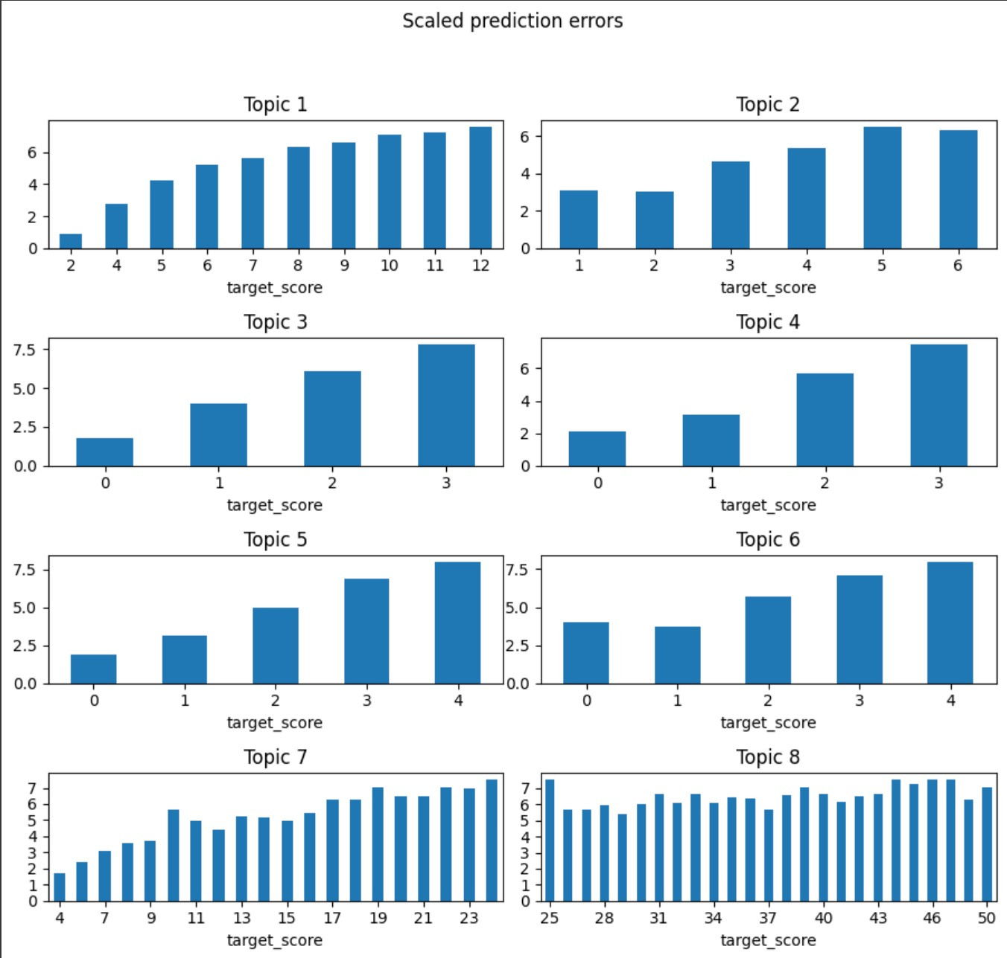

Slide 22
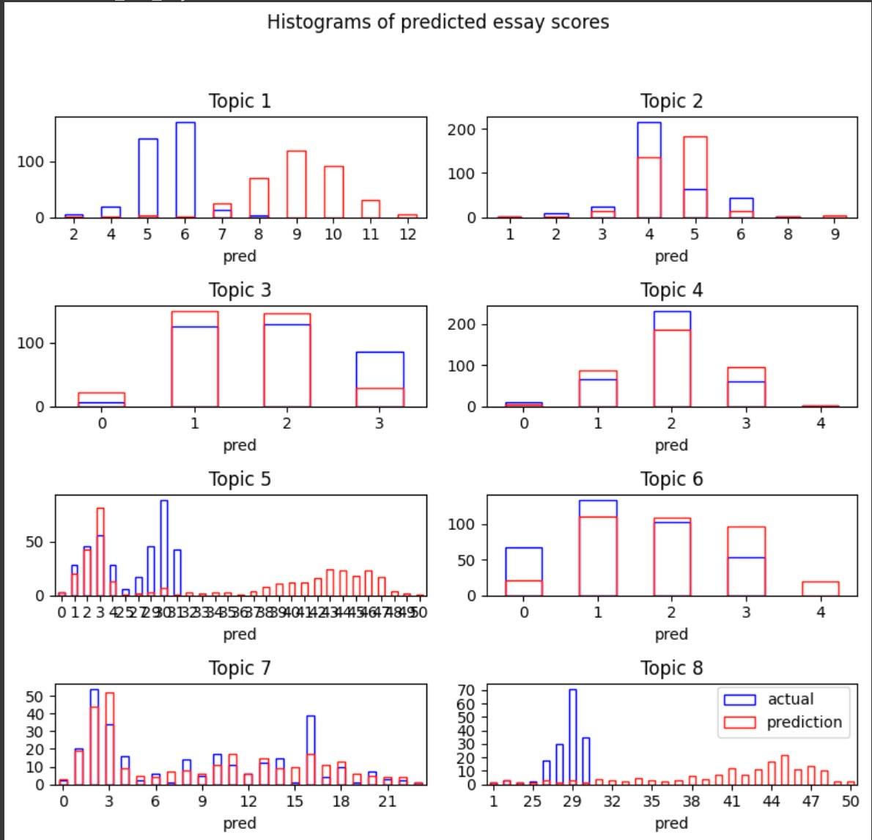
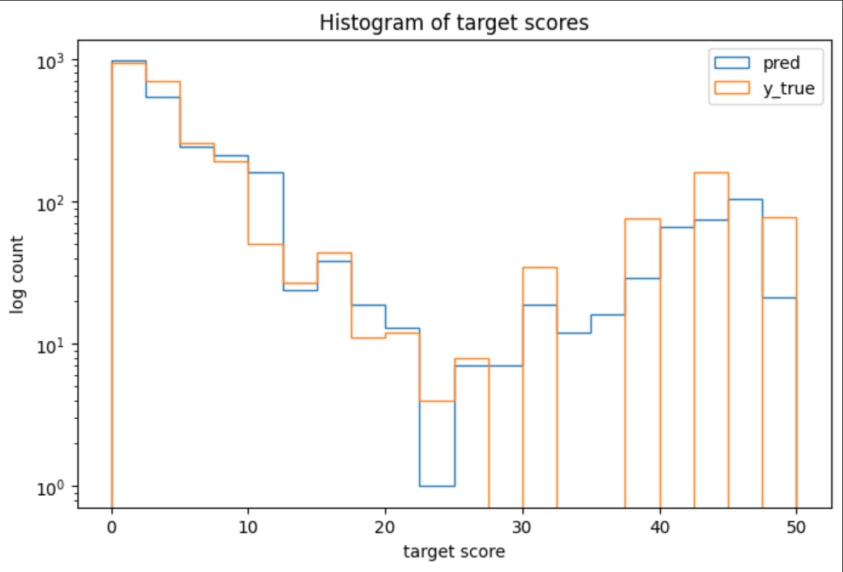

Slide 23
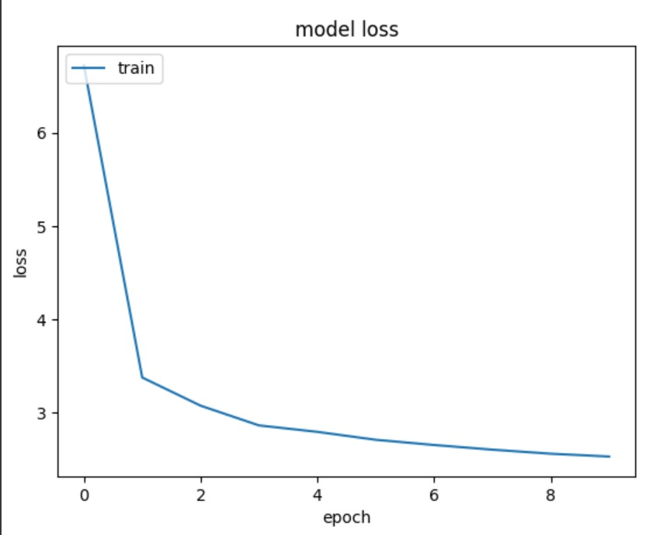
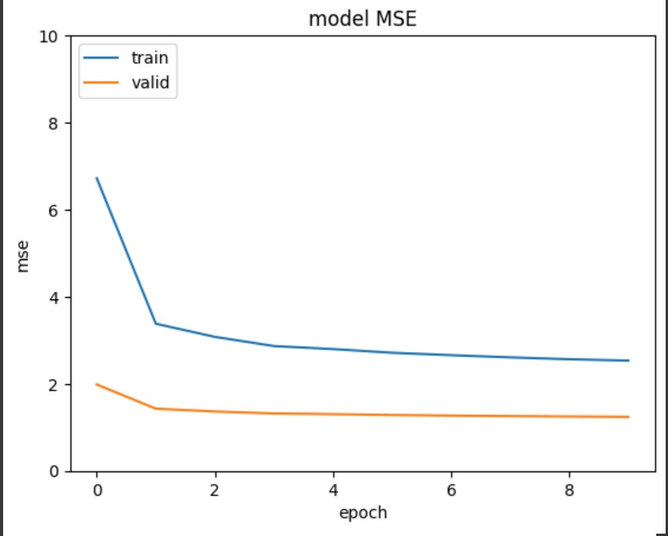

Slide 24
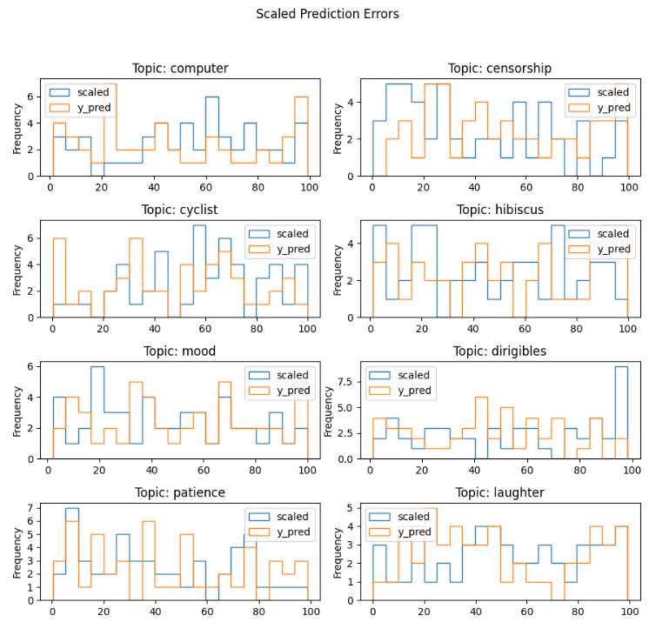
Test Accuracy
This model Predicts target scores with 70.5% accuracy .
This histogram provides a comprehensive view of how predictions are performing across different topics.

Slide 25
Results Analysis
There are several advantages to the automated evaluation approach over the conventional manual grading techniques. It can quickly evaluate a wide range of answers, allowing participants to receive feedback right away. Additionally, the algorithm is skilled at picking up on minute linguistic quirks and mistakes that human assessors could miss, giving a more thorough and detailed examination of language use.
Although the automated evaluation system has its advantages, it is not without flaws. Speech in dialects or accents that significantly differ from those in the training dataset may be difficult for the system to process. Furthermore, there might occasionally be inconsistencies in the score due to its inability to fully understand the context or intended meaning of some comments.

Slide 26
Conclusion
The project aimed to develop a deep learning architecture for automated speech scoring, focusing on enhancing language assessment techniques.
Through the utilization of techniques such as deep neural networks, the model exhibited promising results in automating speech scoring, thereby contributing to the field of language assessment.
Evaluation metrics were employed to assess the model's accuracy and efficiency in language proficiency evaluation, highlighting its potential in practical applications.
Despite achieving significant milestones, the project acknowledges certain limitations such as data size and potential biases, emphasizing the need for further refinement and validation.

Slide 27
References
Hussein, M. A., Hassan, H., & Nassef, M. (2019). Automated language essay scoring systems: A literature review. PeerJ Computer Science, 5, e208.
Bachman, L., & Adrian, P. (2022). Language assessment in practice: Developing language assessments and justifying their use in the real world. Oxford University Press.
Brown, J. D., & Hudson, T. (1998). The alternatives in language assessment. TESOL quarterly, 32(4), 653-675.
Giraldo, F. (2018). Language assessment literacy: Implications for language teachers. Profile Issues in TeachersProfessional Development, 20(1), 179-195.
Shohamy, E. (2020). The power of tests: A critical perspective on the uses of language tests. Routledge.

Slide 28
Thank You
- Group 15

